Slide 1
Presenting my town Trikala
Nafsika kougiouta
3rd Junior High school of Trikala

Slide 2
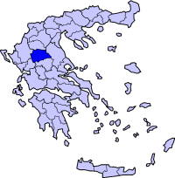
Location
Trikala is a small town in the center of Greece. Trikala is one of the ten most ancient towns in Europe.It built on the ruins of the ancient town Trikki which was founded in the 3rd millennium BC . Homer mentioned in Iliada that Trikki took part in the Trojan war. At the middle ages it became a great financial centre and during the it developed in a cultural centre .In 1881 Trikala was liberated and became part of Greece. Although Trikala is small, it is a well developed and interesting town.

Slide 3
River Litheos
Trikala is a provincial town with a lot of beautiful sights and a great natural environment. Trikala’s most important sight is river Litheos that crosses the town and divides it in two parts and is, at least was considered the fig of our town. People say that Asklipios the ancient god of medicine was born by the river Litheos. Its name comes from the word “Lithi” which means oblivion. Wonderful old bridges connect the two sides of our town.

Slide 4
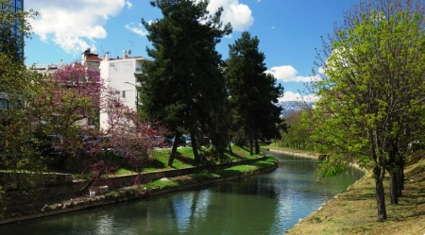
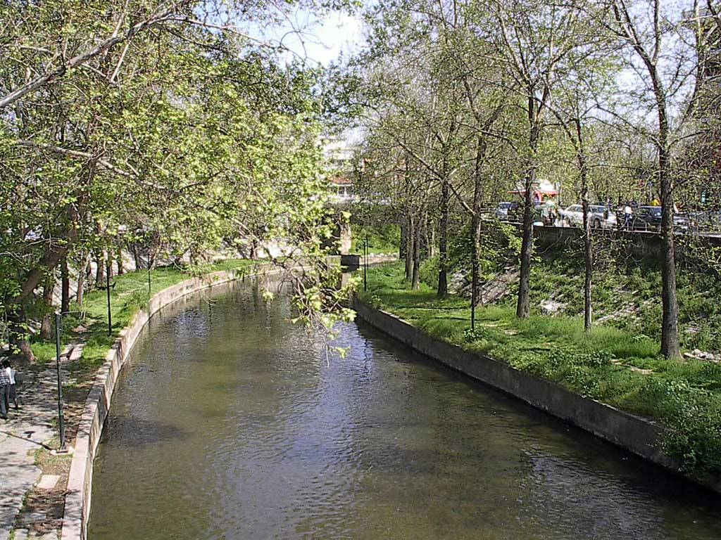
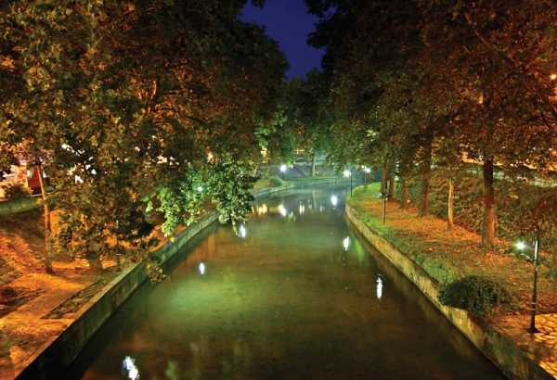
River Litheos

Slide 5
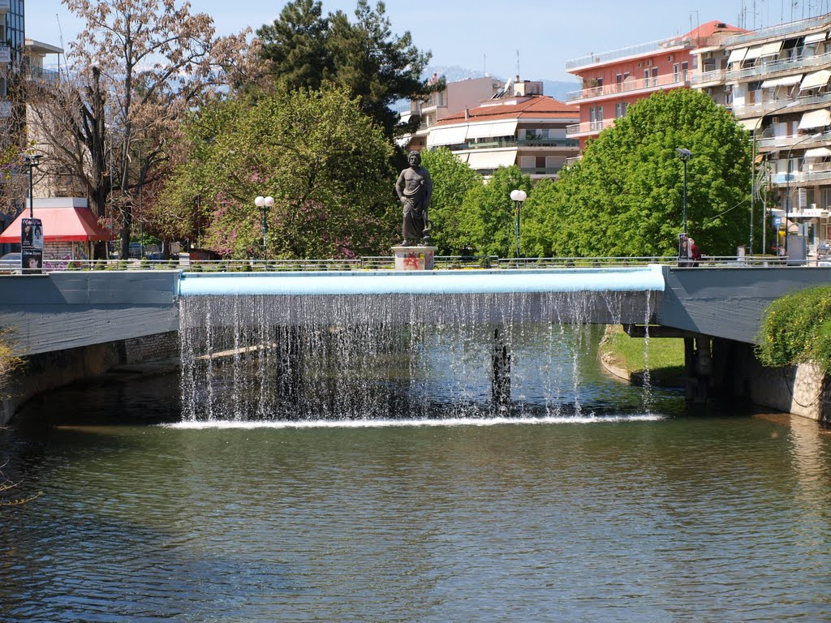
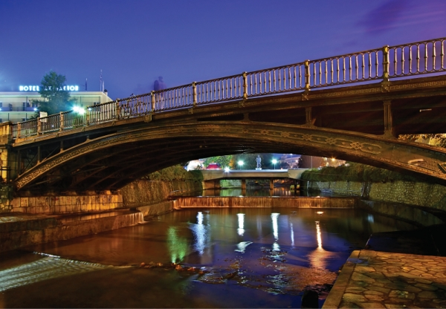
The central bridge constructed in 1886 by French mechanicals
The statue of Asclipios next to Lithaios

Slide 6
The Castle
The castle of Trikala is located in one of the tallest peaks of the town .It is said that it was built by emperor Ioustinianos in the sixth century B.C. In the castle there is the trademark of our town which is the clock that was constructed by Turkish men in the seventieth century AD from where someone can admire the panoramic view of Trikala. There is also a café and a provisional theatre.

Slide 7
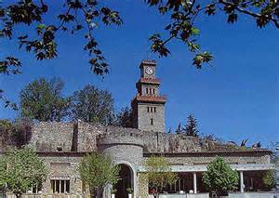
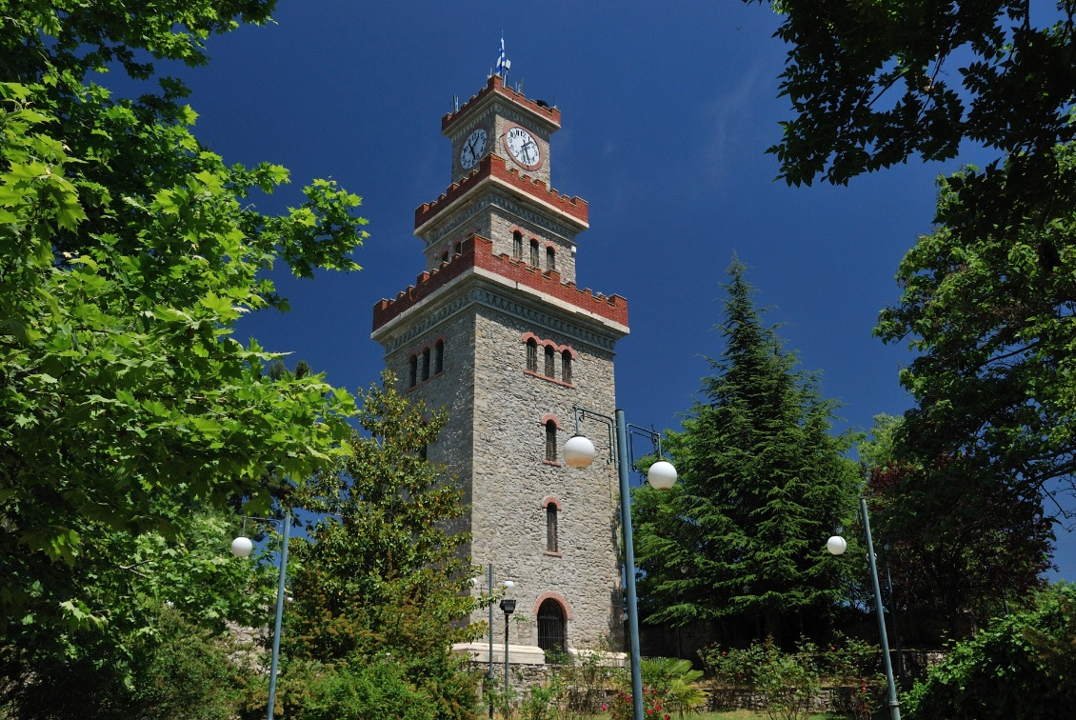
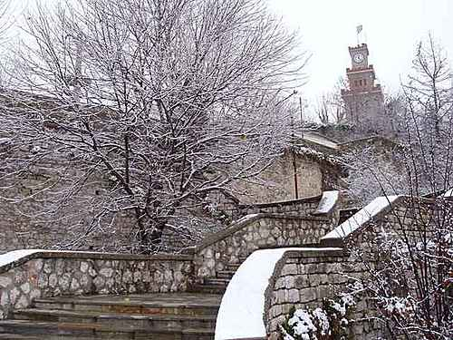
The clock ,the trademark of our town

Slide 8
The Koursoum mosque
It is believed that prince Osman Sah was sick and he recovered in Trikala so he constructed it in memory of his rescue. Ιt was build by the famous Greek architect Sinan in the middle of the sixteenth century and it is known for its dome which is made of lead. Nowadays there are held many events such as art exhibitions. At the same location there is the Orthodox temple of Saint Konstantinos.

Slide 9
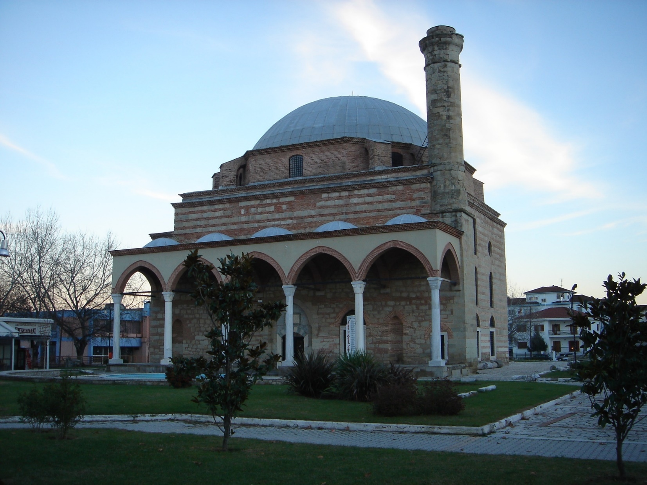
Koursoum Mosque

Slide 10
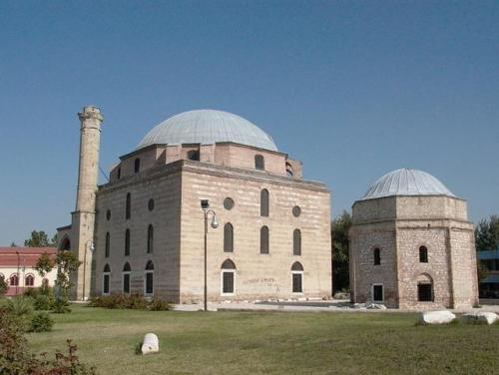
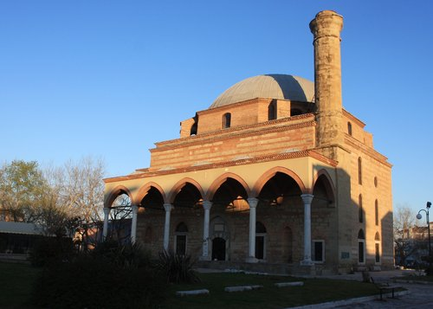
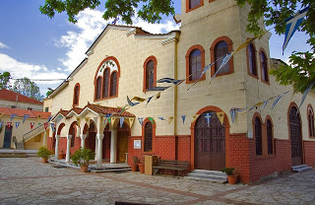
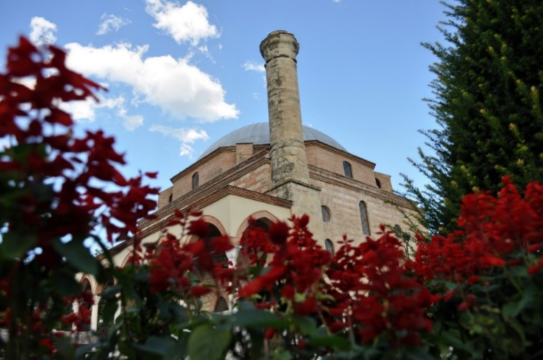
Koursoum Mosque
Saint Konstantinos church

Slide 11
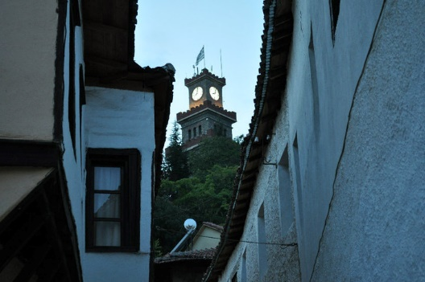
The old town Varousi
Varousi stands out for its beautiful old houses that are famous for their unique architecture. Someone can enjoy their walk in the beautiful and scenic alleys and admire the special style of architecture .

Slide 12
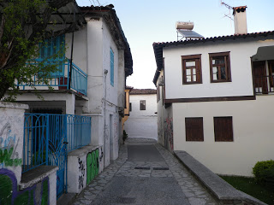
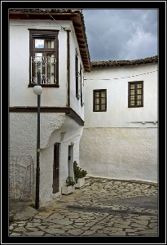
Traditional houses in Varousi

Slide 13
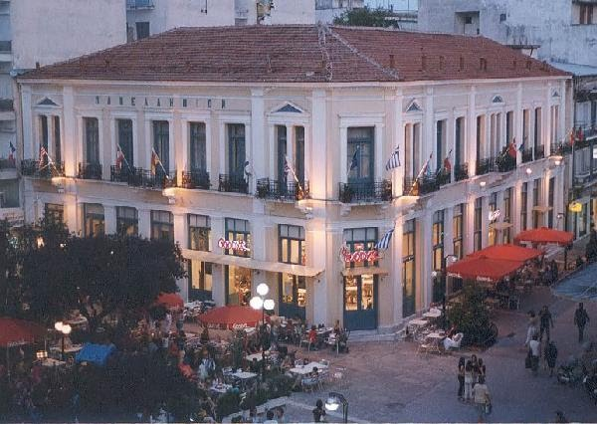
Asklipiou street
It is the most busy and crowded street of our town. There are many stores, someone can find whatever they need , and it’s very famous for the cafés . It is named after the god of medicine Asclipios. It is full of people all day every day.

Slide 14
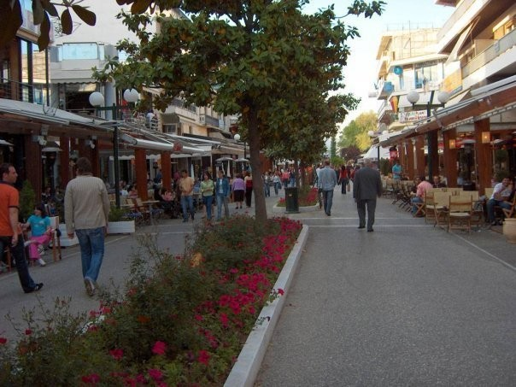
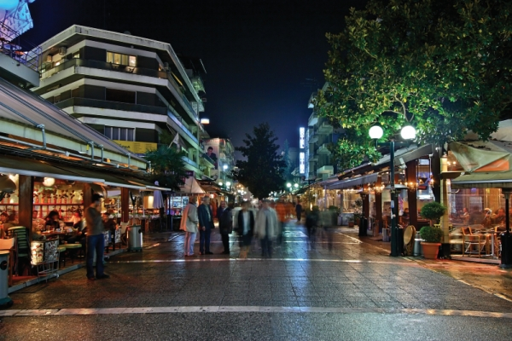
Asklipiou street
Asklipiou street at night

Slide 15
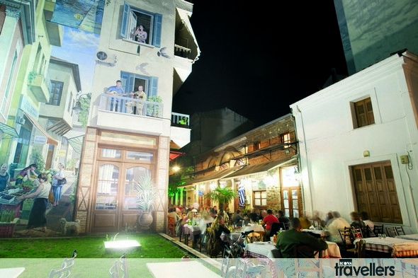
Manavika
Manavika is a district very famous for its restaurants. It is one of the oldest districts in Trikala that are restored and it has turned into a very trendy food destination. Someone can taste incredible and delicious dishes and try some of the traditional products such as dairy products , sausages and meat.

Slide 16
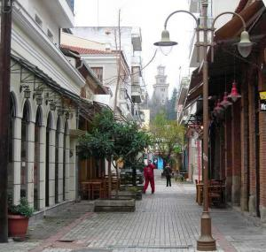
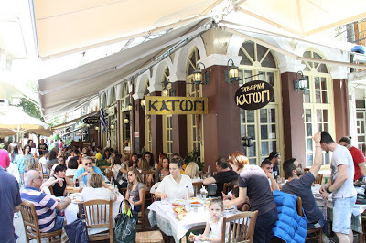
Manavika

Slide 17
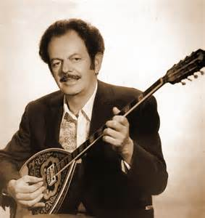
Trikala the town of music
Trikala is the home town of many famous Greek musicians including one of the most well known Greek composers ever Vasilis Tsitsanis.

Slide 18
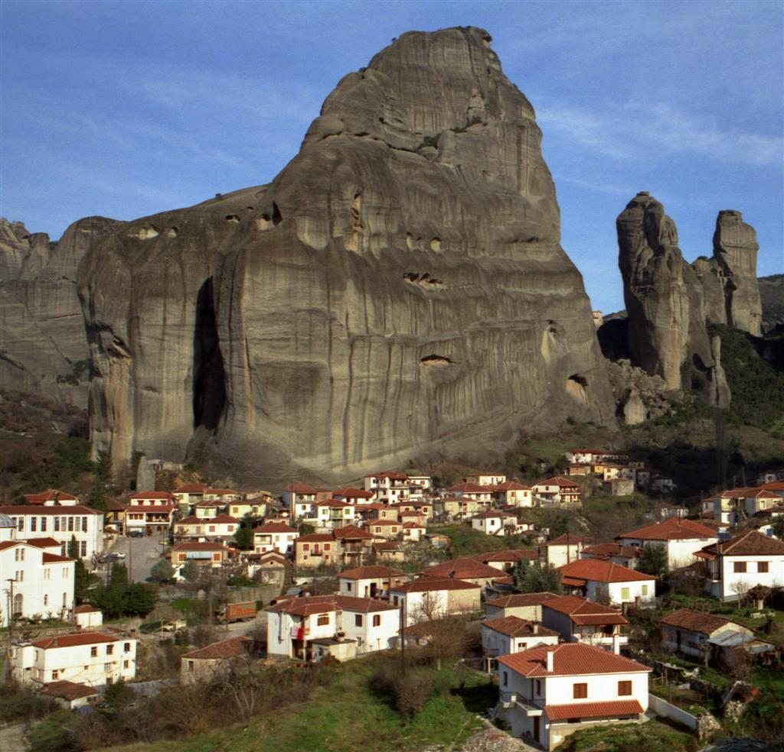
Meteora
Near Trikala in a small town , Kalampaka ,nature has created a magnificent scenery. Huge stones known as Meteora dominate over the town. It is the second bigger monastic area in Greece after Athos. There are build many monasteries on the top of the stones dated back from the 7th century AD. It was also used as scenery for a James Bond film many years ago.

Slide 19
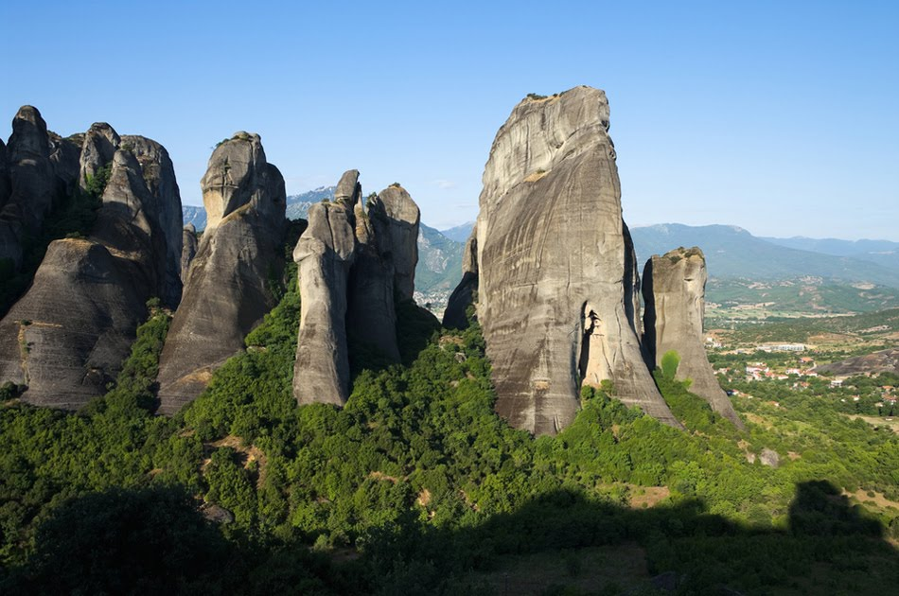
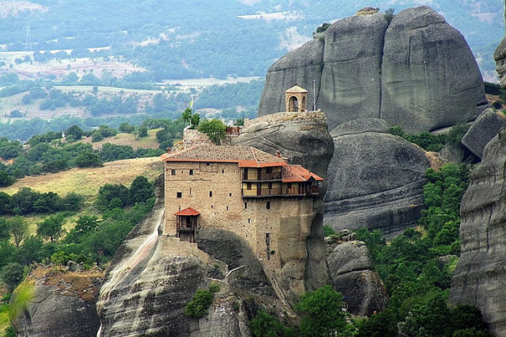
Meteora
A monastery

Slide 20
THE END

