Slide 1
3rd Junior High School of Trikala
Celia Manos

Slide 2
A few things about our school
Our school is the 3rd Junior High School in Trikala. It opened in 1937, as a school destined only for girls. Since 1979, boys have been allowed to attend.

Slide 3
Our school in the past

Slide 4
Our school now.
Today our school is a modern building. It has changed a lot since the last century. Today 23 teachers work in it and the students are divided in 10 classes.

Slide 5
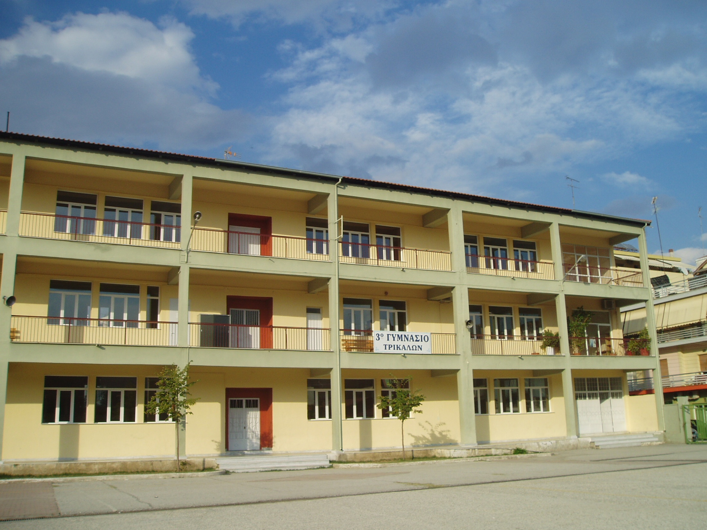
The Yard
The yard houses the 9th Junior High School, as well. We spend our school breaks relaxing and having fun. In the yard, there is also a canteen where both professors and students can get a snack.

Slide 6
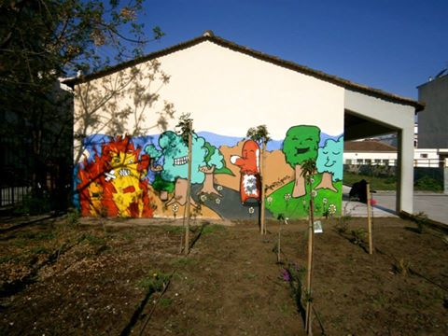
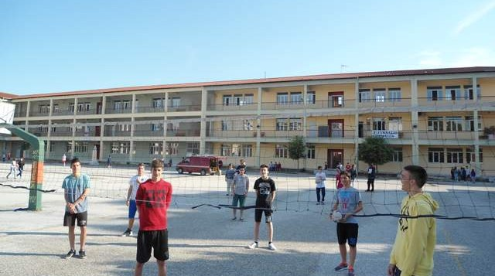
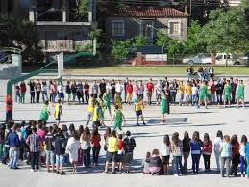
Our Yard

Slide 7
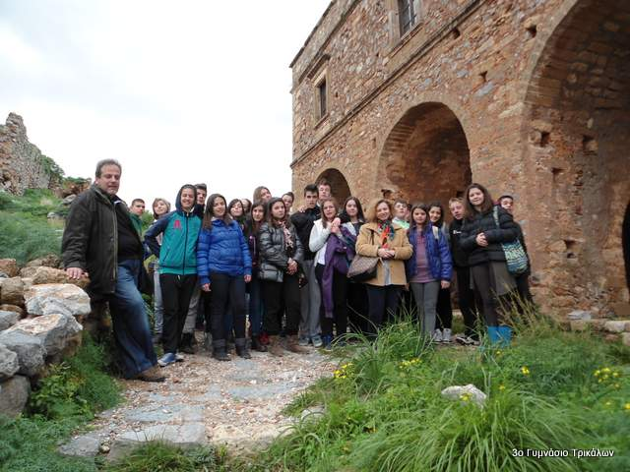
School Activities
Children have the opportunity to take part in school activities. These activities help students to broaden their horizons and to learn how to cooperate. Furthermore, students get the chance to go on excursions and visit new places.

Slide 8
Educational Programs
Many of our school’s programs have educational purpose such as the protection of the environment, music, our town’s history, health and alternative ways of learning. Additionally, students can join the school choir and recite poems at school celebrations.

Slide 9
Athletic Activities
Athletic activities are organized every year in the school yard. Through them, well-being and physical activity is promoted.

Slide 10
The End!
Sources:
Wikipedia
http://3gym-trikal.tri.sch.gr/

