Slide 1
Our School – 3rd Junior High School of Trikala
Athanasia Adamou
Sotiria Konstantakou

Slide 2
Our school

Slide 3
History
Our school firstly operated in 1937 as a school only for girls. In 1945 studied 438 female students and worked 5 teachers, while in 1964 the school had 2.127 female students, which were taught by 62 teachers. In year 1979 the school transformed into a mixed school.

Slide 4
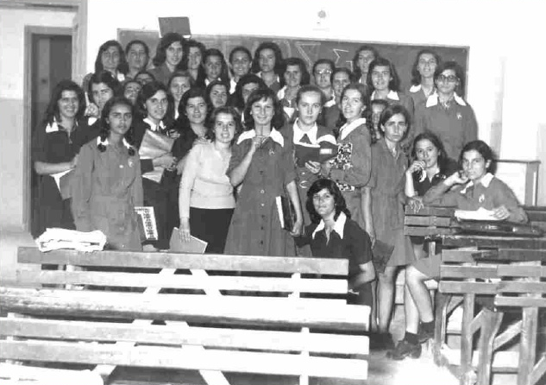
History

Slide 5
Our school today
Today our school has 23 professors for all subjects and approximately 265 students.
There are 10 classes : 3 for the students of 1st Grade , 3 for the students of 2nd Grade and finally 4 for the students of 3rd Grade.
Our school has also: a fully equipped physics-chemistry lab , a computer lab , a German class, a class for multiple use, a class with interactive whiteboard, an art class and a gym.

Slide 6
Our school today
Physics – Chemistry Lab
Computer Lab

Slide 7
Our school today
Multiple Class
German Class

Slide 8
Our School today
In the groundfloor there are 4 classes, the toilets and the art class.
In the second floor there are the headmaster’s and teachers’ office as well as the secretary. Moreover, there are the multiple class, the class with the interactive board and the computer lab.
In the third floor there 7 classes and the German class.

Slide 9
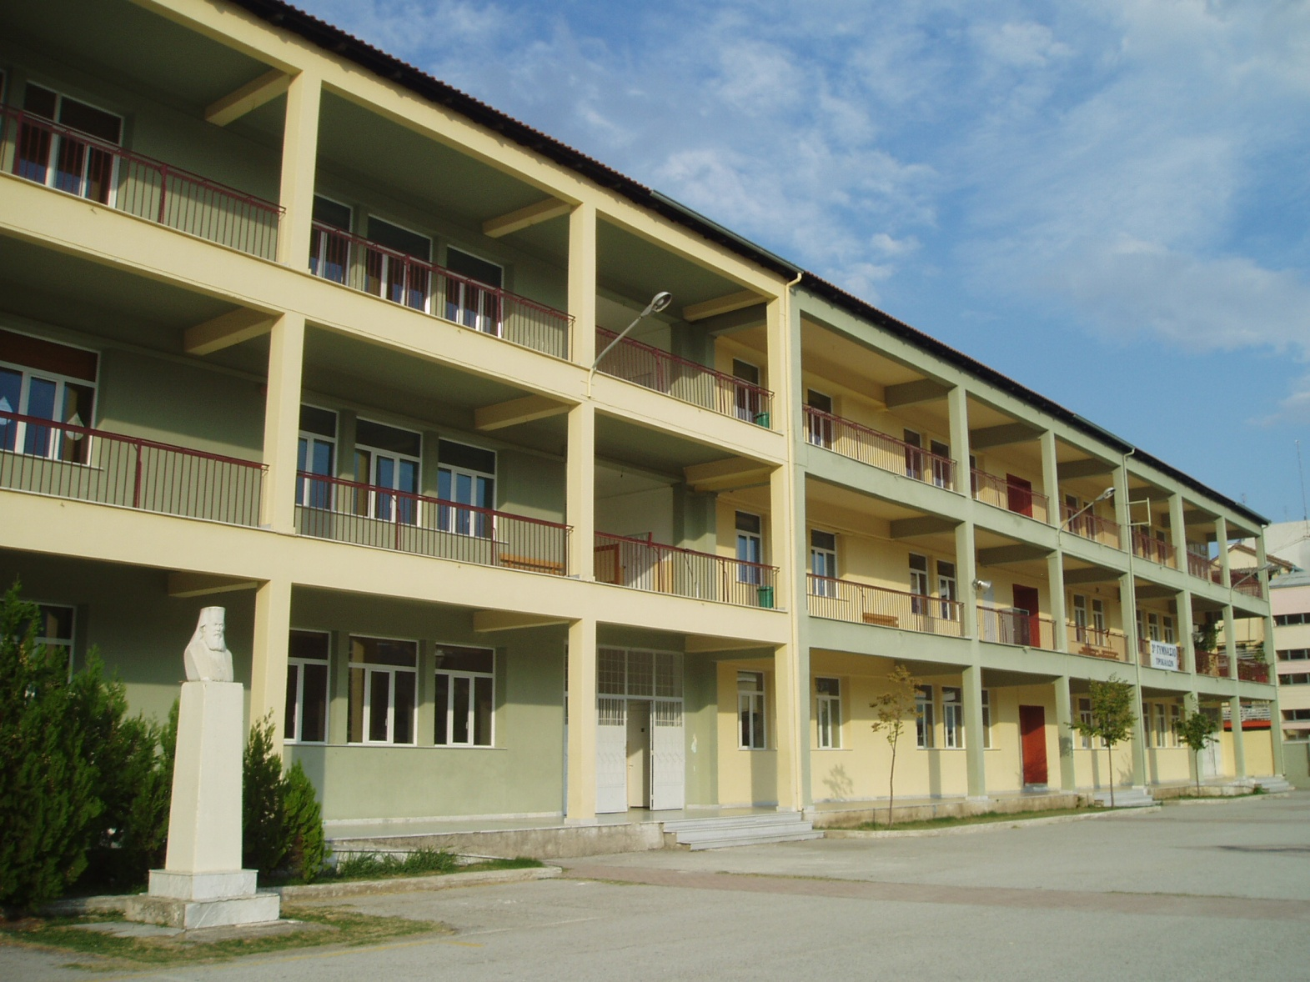
Our School today

Slide 10
Our School today
Our school has a really large and beautiful yard, surrounded by tall trees and colorful flowers.
In the yard there are both basketball and volleyball court. What is more, there is a cantina, in which students can buy something to eat during the breaks.
At the end of the yard there is a small garden, where the students have planted there own trees.
Our school is decorated by graffiti art, which is really impressive because students have drawn them on their own.

Slide 11
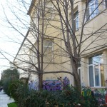
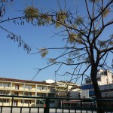
Our School today

Slide 12
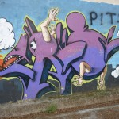
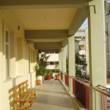
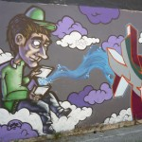
Our School today

Slide 13
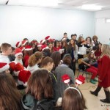
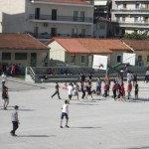
School activities
Every year our school holds celebrations for our national anniversaries or Christmas, in which students participate as members of choir and orchestra. In addition, some students recite poems.
One day every year our school organizes sports activities.

Slide 14
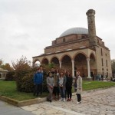
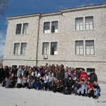
School activities
We visit some sights of our city or attend certain presentations about culture.

Slide 15
School trips
Our school with the aid of our teachers organizes every year a number of school trips around Greece.
In particular, our school has visited many Greek cities , for example: Nafplio , Livadeia , Corfu , Thessaloniki , Athena , Parga , Volos , Larisa.

Slide 16
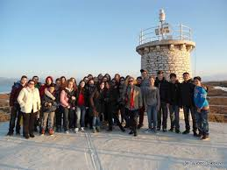
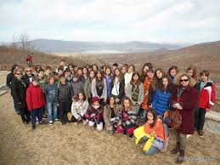
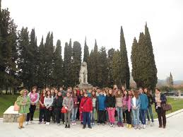
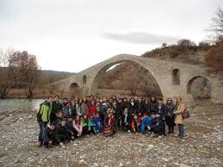
School trips

Slide 17
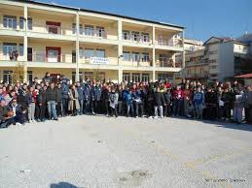
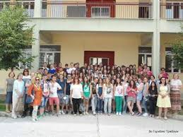
Our School

Slide 18
The end

