Slide 1
TRIKALA
CHRISTOS KOKKONIS

Slide 2
TRIKALA
Trikala is a city in northwestern Thessaly, Greece, and the capital of the Trikala regional unit. The city straddles the Lithaios river, which is a tributary of Pineios . According to the National Statistical Service, Trikala is populated by 81,355 inhabitants (2011), while in total the Trikala regional unit is populated by 131,085 inhabitants (2011).

Slide 3
HISTORY
The city of Trikala is built on the ancient city Trikka or Trikke, which was founded around the 3rd millennium BC and took its name by the nymph Trikke, daughter of Penaeus , or according to others, daughter of Asopus river. The ancient city was built at a defensive location in between the local hill and the river Lithaios. The city became and important center in Antiquity and it was considered to be the birthplace and main residence of the Healing God Asclepius. The city exhibited one of the most important and ancient of Asclepius temples asclepieia. The city is mentioned in Homer's Iliad as having participated in the Trojan War with thirty ships under Asclepius' sons Machaon and Podalirius. In the Mycenean period, the city was the capital of a kingdom, and later it constituted the main center of the Thessalian region of Estaiotis, which occupied roughly the territory of the modern Trikala Prefecture.

Slide 4
Sights
The archaeological site of Asklepieion
The Byzantine Castle
The Osman Shah Mosque
The Old City of Trikala
The hill of Prophitis Ilias
Lithaios river and the Central Bridge
The Mill of Matsopoulos

Slide 5
Asklepieion
The archaeological site of Asklepieion of Trikke, the most significant and the most ancient of Greece, according to Strabo

Slide 6
The Byzantine Castle
The Byzantine Castle, built by Justinian onto the acropolis of ancient Trikke in the 6th century AD. Later it was rebuilt by the Ottomans, who in the 17th century placed a huge clock tower, which was accompanied by a bell weighing 650 kg . In 1936, another clock tower was placed and today remains the trademark of the city, while offers a panoramic view to the city.

Slide 7
The Osman Shah Mosque
The Osman Shah Mosque (16th century), building designed by Mimar Sinan. Behind the mosque stands the mausoleum of Osman Shah, nephew of Sultan Suleyman the Magnificent

Slide 8
The Old City of Trikala
The Old City of Trikala, which consists of the districts Varousi and Manavika. Varousi was the Christian district of Trikala during the Turkish rule and is located at the foot of the fortress. Until 1930, this part of the city was considered as the noble district of Trikala and is now preserved in its entirety, with a large number of old buildings, built between 17th and 19th century, preserved until today . In this part are located the oldest churches of the city. Following the district Varousi up to the central square is the part of the city called Manavika, a neighborhood of the old city with a uniform architecture

Slide 9
Lithaios river and the Central Bridge
Lithaios river and the Central Bridge, built in 1886, which connects the central square with the Asclepius pedestrian zone.

Slide 10
The Mill of Matsopoulos
The Mill of Matsopoulos, which was constructed in 1884 and today is a historical-industrial building and cultural center. During the Christmas period, the stone-built Matsopoulos Mill transforms into the “Mill of Elves”, a famous Christmas park

Slide 11
Museums
Archaeological collection of Triki
Municipal Folklore Museum
Municipal Historical Sports Museums
Dimitris and Legkos Katsikogianni Museum
Holy Metropolis Museum
The Mill of Matsopoulos

Slide 12
Trikala Sporting Teams
Trikala F.C
Trikala 2000 B.C.
Aries Trikala B.C

Slide 13
Pertouli
Pertouli is a small mountain village within the province of Trikala in Greece and is situated at an altitude of 1,150 metres on the central part of the Pindos mountain range.
The name Pertouli is most famous for the nearby Ski resort that is very popular with snow sports fans in central Greece.

Slide 14
City Mobil 2(Automated Bus)
The door closes and the journey begins. But there is no driver or passenger. It is not a mirage, though some speak of the miracle of technology. This is the first bus without a driver traveling in the center of Trikala.
The Thessalian city won a world first prize. It is the first who dared to launch automated vehicle next to cars and pedestrians

Slide 15
Meteora
The Metéora (Greek: Μετέωρα ), lit. "middle of the sky", "suspended in the air" or "in the heavens above" — etymologically related to meteorology) is one of the largest and most important complexes of Greek Orthodox monasteries in Greece, second only to Mount Athos. The six monasteries are built on natural sandstone rock pillars, at the northwestern edge of the Plain of Thessaly near the Pineios river and Pindus Mountains, in central Greece. The nearest town is Kalambaka. The Metéora is included on the UNESCO World Heritage List

Slide 16
Vassilis Tsitsanis
Vassilis Tsitsanis was a Greek songwriter and bouzouki player. He became one of the leading Greek composers of his time and is widely regarded as one of the founders of modern Rebetika. Tsitsanis wrote more than 500 songs and is still remembered as an extraordinary bouzouki player.

Slide 17
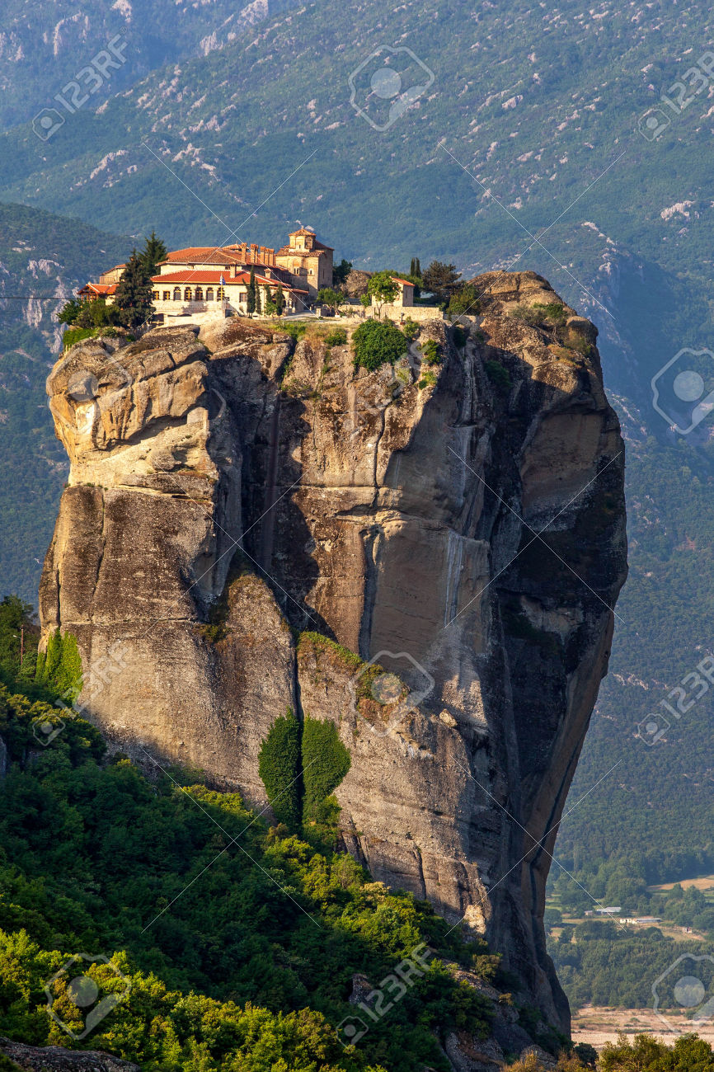
Images

Slide 18
Sources of Information
https://el.wikipedia.org/wiki/Trikala

Slide 19
THE END
CHRISTOS KOKKONIS

