Slide 1
Our town, Trikala
Katia Kouti

Slide 2
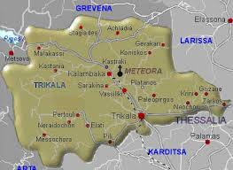
Our town
Trikala is a town in northwestern Thessaly, Greece, and the capital of the Trikala regional unit. The city straddles the Lithaios river, which is a tributary of Pineios. It is said that Asklipios, the most important doctor of antiquity, originated from here.

Slide 3
A brief introduction to our town’s sights
Trikala is a town with much to visit. The town combines tradition with modernization. Some of trikala’s worth visiting attractions are:
The fortress
The Lithaios river
Varousi, the traditional neighborhood
The mill of Matsopoulos
The Osman Shah Mosque and much more

Slide 4
The Fortress of Trikala
History
The fortress today
The fortress of Trikala was constructed by Justinian the 1st in the 6th century where the ruins of the citadel of ancient Trikke used to lay. During the fall of the city by the Ottomans, some parts of the castle were destroyed although they soon discovered that it could play a great strategic role therefore they preserved what we can still see nowadays. The castle was, by all means, an important safety factor for the development of the whole settlement
On the eastern side of the fortress there is a large clock wich was constructed in the mid 17th century. The fortress today hosts the outdoor theatre of the city, where each summer a variety of theatrical performances is held.

Slide 5
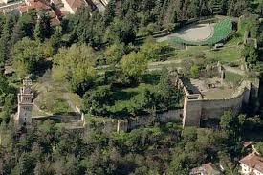
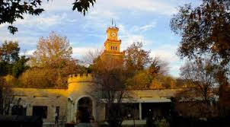
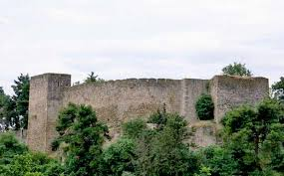
The Fortress

Slide 6
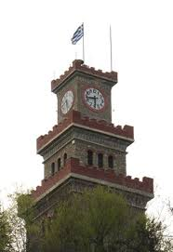
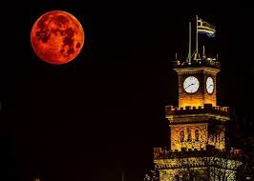
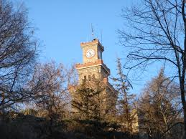
The clock
The Clock Tower offers a spectacular view of the entire city and large parts of the Thessalic plains from its top. All you have to do is climp a few stairs which will reward you for your effort. The best time to visit the fortress and its clock within the day is at sunset. Have a sit at the stairs and enjoy thε majestic nature that surrounds it.

Slide 7
Varousi
The Old City of Trikala consists of the districts Varousi and Manavika. Varousi was the Christian district of Trikala during the Turkish rule and is located at the foot of the fortress. Until 1930, this part of the city was considered as the noble district of Trikala and is now preserved in its entirety, with a large number of old buildings, built between 17th and 19th century, preserved until today . In this part are located the oldest churches of the city. Following the district Varousi up to the central square is the part of the city called Manavika, a neighborhood of the old city with a uniform architecture . Here are located some of the best restaurants and coffee bars in town.

Slide 8
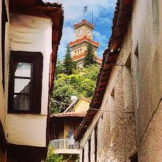
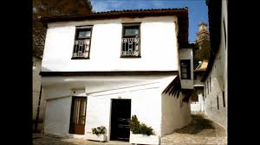
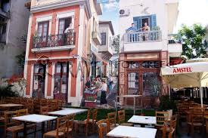
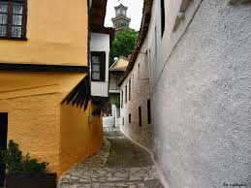
Varousi-Manavika

Slide 9
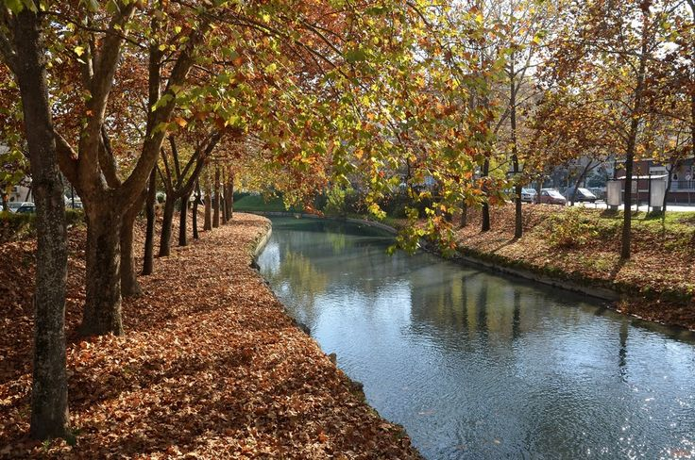
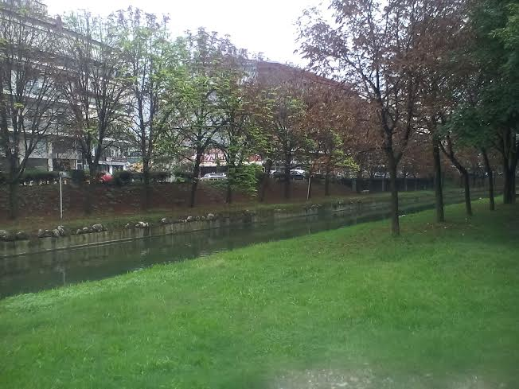
The Lithaios River
Lithaios river flows throught the city enhancing its beauty. The Central Bridge was built in 1886 and connects the central square with the Asclepius pedestrian zone.

Slide 10
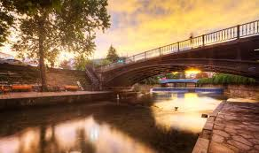

Slide 11
The Osman Shah Mosque
Koursoum Mosque awakens the memories of another historical era and brings to the minds of visitors images from the civilization of the east. Tradition has it that prince Osman Shah, son of Sultan Suleiman arrived hunted and sick in Trikala. Because he was healed in Trikala, he built the Mosque in memory of his being saved. The Mosque was built in mid 16th century. Visitors stand in awe before its size. The dome is 18m in diameter and 22m from the floor. The Mosque was reconstructed in1993. Today it is used for low-key events, such as artwork exhibitions and speeches. The beautiful sight is completed by the water fountain at the entrance and lush greenery of the surrounding grounds.

Slide 12
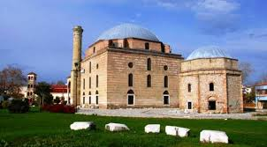
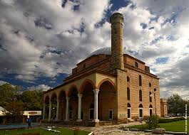
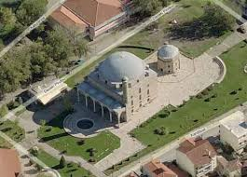
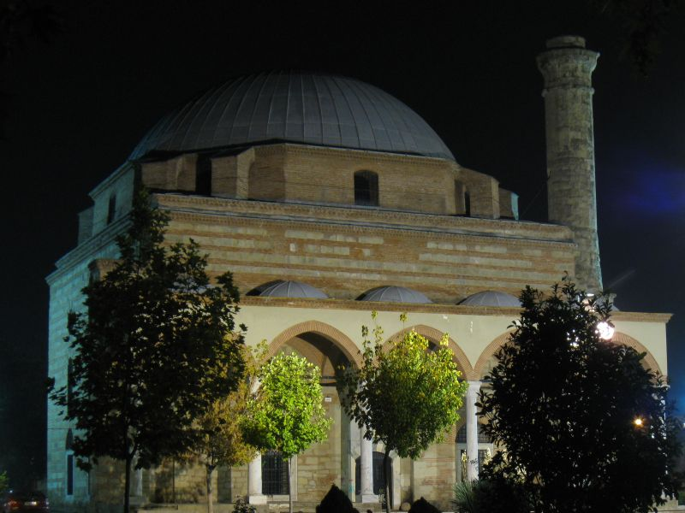
The Osman Shah Mosque/ Koursoum Mosque

Slide 13
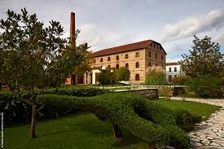
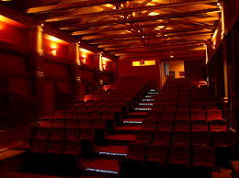
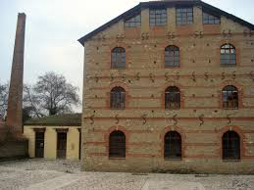
The Mill of Matsopoulos
The Matsopoulos Mill is located in the Park complex, on the NW side of town. It was built in 1884 and is today a historic / industrial monument in the middle of a luscious green park. The Mill, which is for the most part restored today, operates as a cultural center. Here is also the permanent Municipal Cinema the Municipal Theater and a café. There is also a conference hall and a cultural events hall.

Slide 14
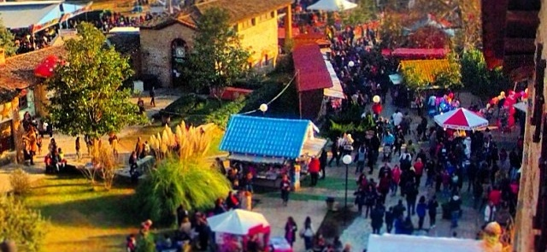
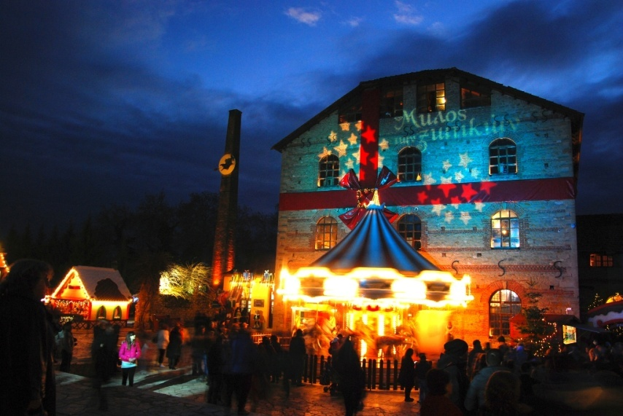
The Mill of.… Elves!
Between the 28th of November and the 4th of January Matsopoulos Mill transforms into the “Mill of Elves” welcoming people of all ages into a festive ambience. Various activities connected with the Christmas celebration take place and amuse people of all the corners of the world.

Slide 15
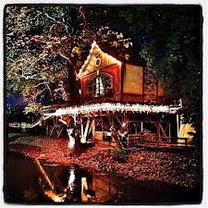
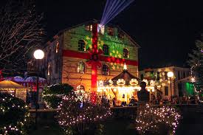

Slide 16
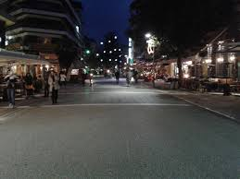
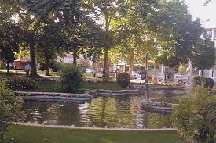
Asklipiou street
Trikala is also a mordenized town with a wide selection of night life activities. Asklipiou the central pedestrian street, with commercial stores and the most popular coffee shops. This is where the residents and visitors of Trikala meet and gather.

Slide 17
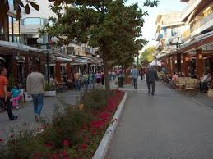
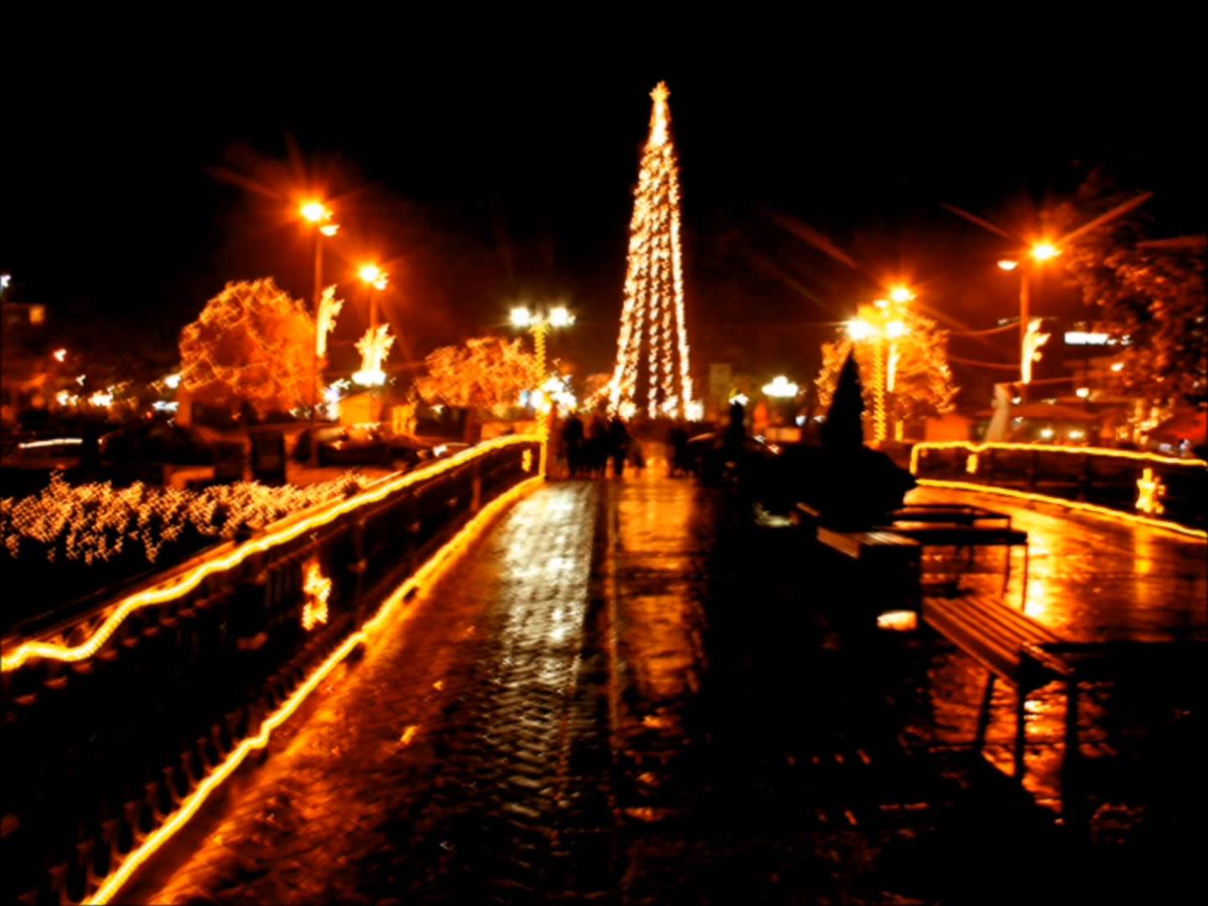
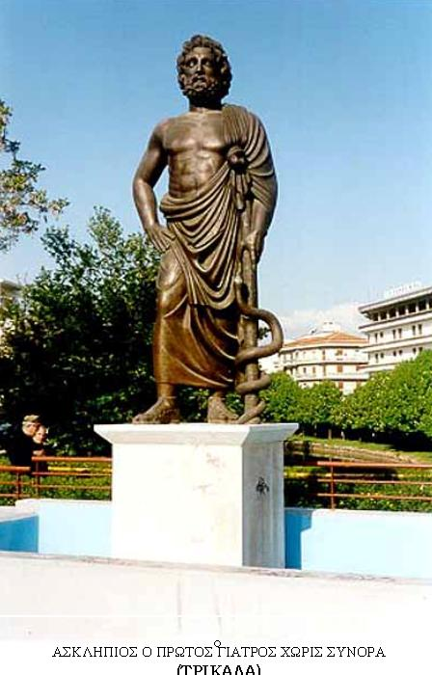
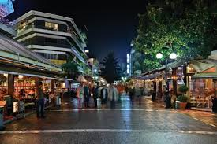

Slide 18
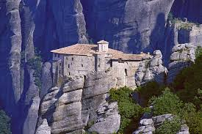
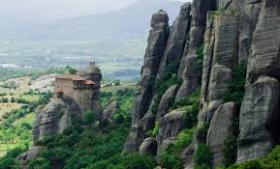
Near-by destinations
Should someone visit our town, they should visit Meteora in Kalabaka. Meteora is one of the largest and most important complexes of Greek Orthodox monasteries in Greece. The monasteries are built on natural sandstone rock pillars, at the northwestern edge of the Plain of Thessaly.

Slide 19
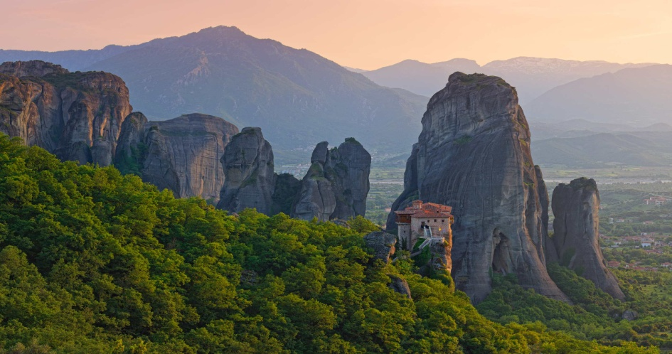
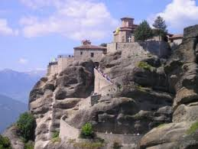
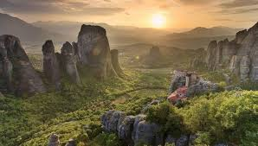
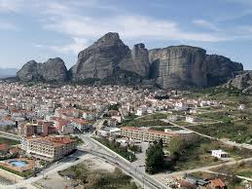

Slide 20
The end
SOURCES:
Wikipedia,
http://www.trikala-tourism.gr/portal/page/portal/etrikala/publicinfo/fortress

