Slide 1
3rd Junior High School Of Trikala
Nafsika Kougiouta

Slide 2
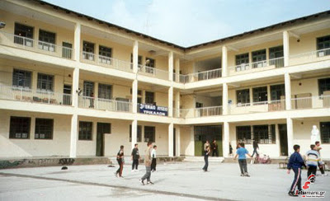
Our school

Slide 3
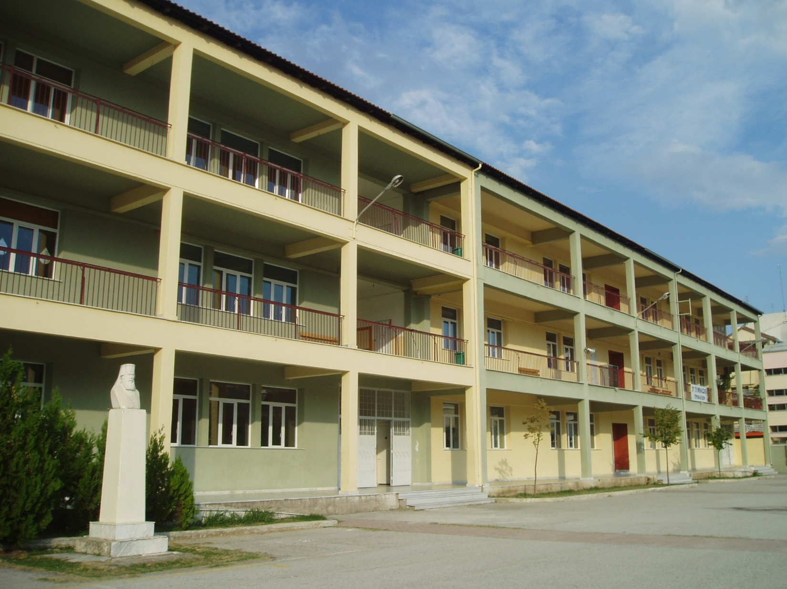
Our school today

Slide 4
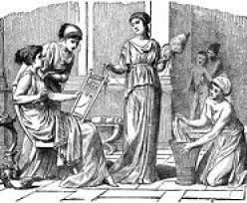
Our School in the past
At the beginning our school functioned as the only Female School of our town since 1939 and was self-contained. It wasn’t until 1979 that Female and Male School were abolished and became co-educational and the school turned into 3rd Junior High school. Our school’s building is one of the oldest of Trikala. You can admire some pictures of that period.

Slide 5
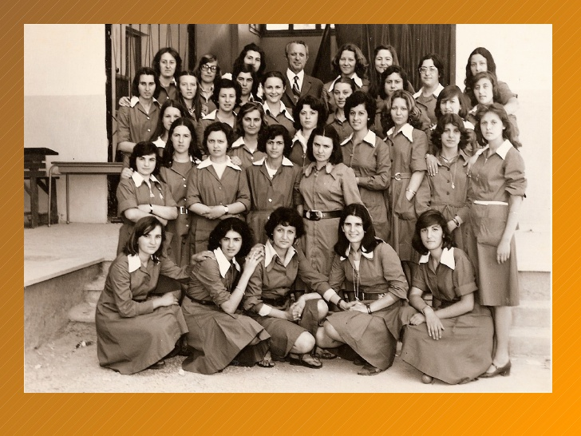
Photos of students with their teachers
Our school in the past

Slide 6
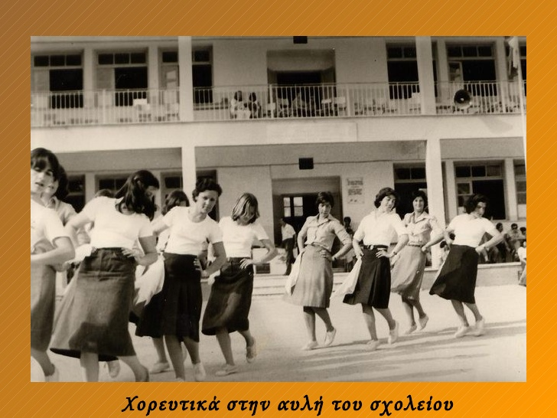
The students dance during a celebration

Slide 7
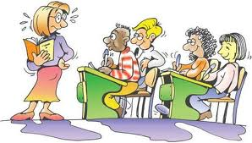
Our school today
The Building:
Our school has three levels. In the 1st and 3rd floor are the classrooms and in the 2nd floor are the teachers’ office, the laboratories and the multiple use rooms. There is a huge yard where students play basketball, volleyball or football and spend their breaks. 250 students study in our school with a really performance which makes it one of the best schools in Trikala.

Slide 8
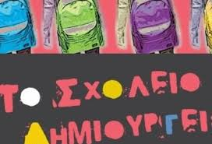
Participation in programs
Our school takes part in many cultural and environmental programs that really interest the students who are willing to take part in. Every year many trips all over Greece are organized. During these programs students have the opportunity to take part in many activities that include visits to environmental parks , museums or exhibitions.

Slide 9
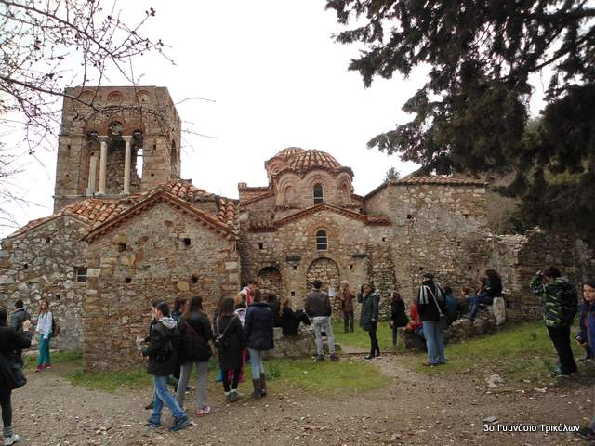
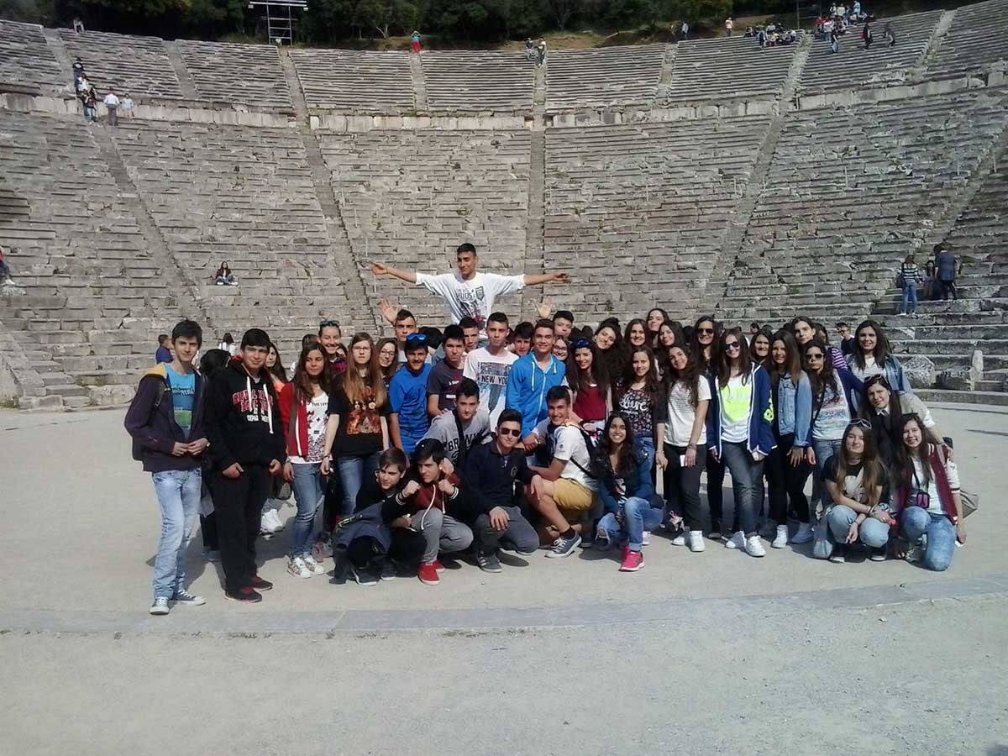
Our school in Nafplio
Our school in Saint Loukas Monastery

Slide 10
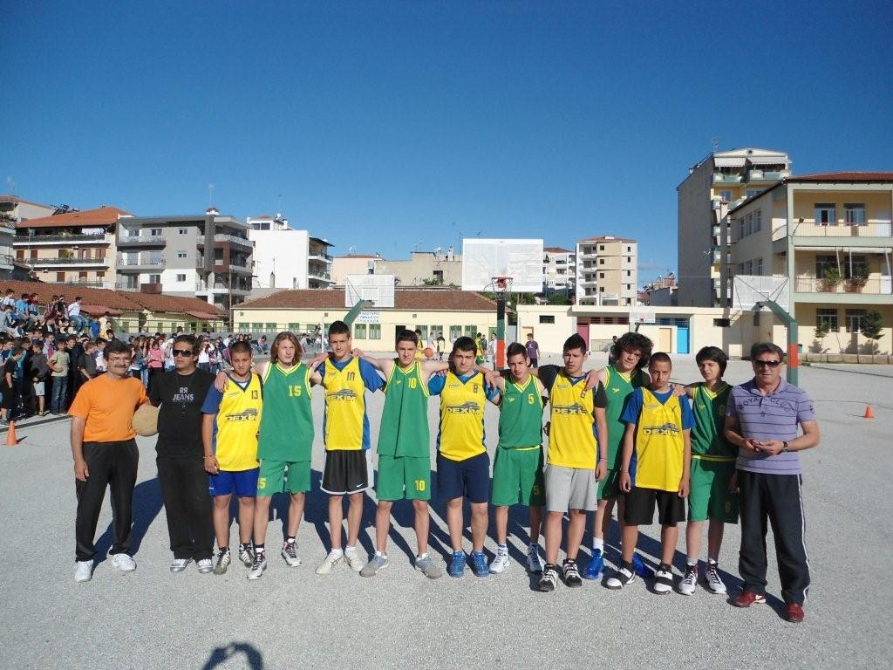
Sport activities
Our school has taken part in many sport activities and competitions between the schools of Trikala and Thessalia and it has won many awards . Our school is present at social and extracurricular events such as our school’s participation in “Digital school” and “School out of borders” . As anyone can understand our school is open to society and tries to provide students with the appropriate knowledge and skills for their lives.

Slide 11
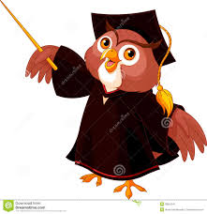
Our school’s society
The most important thing is that in our school are not developed violent incidents. On the contrary, students cooperate really well and get along with each other. Students from another country incorporate easily and are active members of our school life. Of course our teachers do their best to maintain this situation by giving opportunities to anyone so as to prove themselves.

Slide 12
THE END

