Slide 1
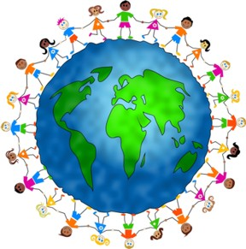
Rights of the Child The meaning of the child and the rights of the children
“Humanity has to do its best for the child.” Declaration of Geneva.

Slide 2
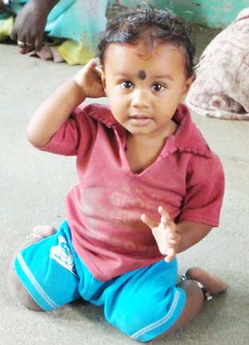
Definition of the child
Etymologically, the term “child” comes from the Latin infans which means ” the one who does not speak “. For the Roman, this term designates the child from its birth, up to the age of 7 years.
The Convention on the Rights of the Child of 1989 defines more precisely the term “child”:
“[…] a child is any human being below the age of eighteen years, unless under the law applicable to the child, majority is attained earlier”

Slide 3
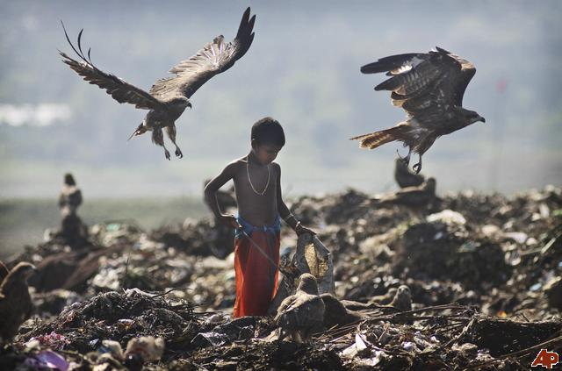
Definition of the rights of the child
Children’s rights were recognised after the 1st World war, with the adoption of the Declaration of Geneva, in 1924. The process of recognition of children’s rights continued thanks to the UN, with the adoption of the Declaration of children’s rights in 1959.
The recognition of the child’s interest and his rights becomes real on 20 November 1989 with the adoption of the International Convention on the Rights of the Child which is the first international legally binding text recognizing all the fundamental rights of the child.

Slide 5
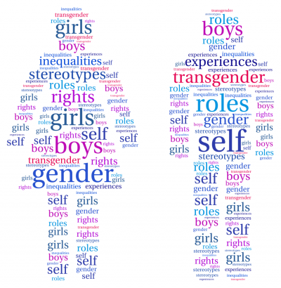
Children’s rights: human rights
Children’s rights are human rights. They protect the child as a human being. As human rights, children’s rights are constituted by fundamental guarantees and essential human rights:
Children’s rights recognize fundamental guarantees to all human beings : the right to life, the non-discrimination principle, the right to dignity through the protection of physical and mental integrity (protection against slavery, torture and bad treatments, etc.

Slide 6
Children’s rights are civil and political rights, such as the right to identity, the right to a nationality, etc.

Slide 7
Children’s rights are economic, social and cultural rights, such as the right to education, the right to a decent standard of living, the right to health, etc.

Slide 8
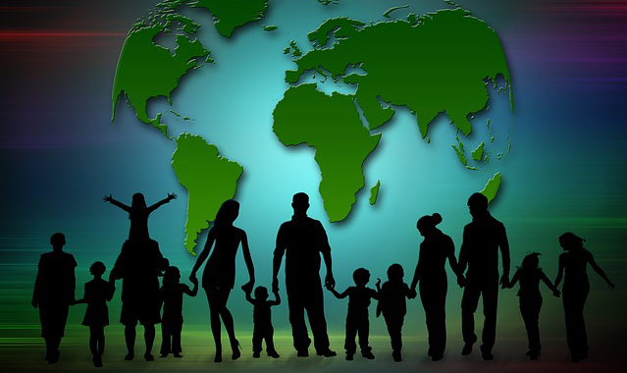
Children’s rights include individual rights : the right to live with his parents, the right to education, the right to benefit from a protection, etc.

Slide 9
Children’s rights include collective rights : rights of refugee and disabled childrens, of minority children or from autochtonous groups.

Slide 10
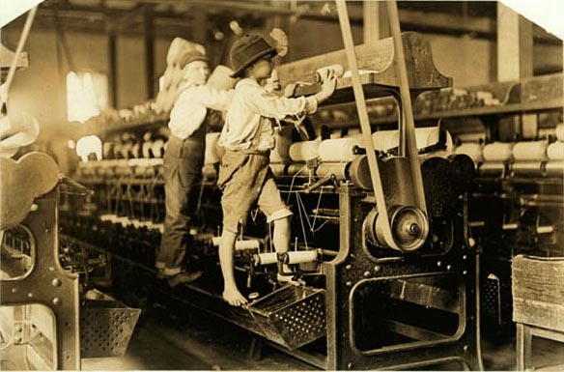
So, the children have to be helped and supported and must be protected against labour exploitation, kidnapping, and ill-treatment, etc.

Slide 12
Business as usual is not enough to make the vision of the Convention a reality for all children. The world needs new ideas and approaches, and the Convention must become a guiding document for every human being in every nation.

Slide 13
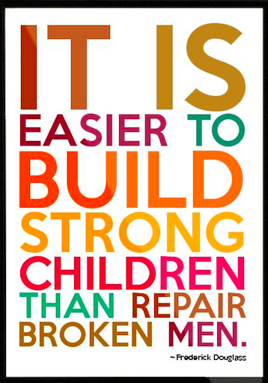

Slide 14
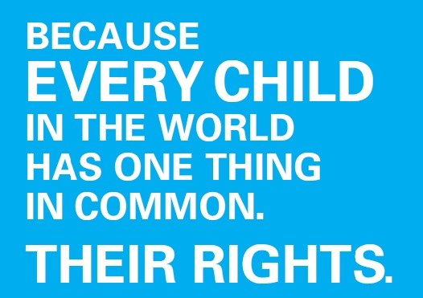
Children's rights Resourses
Wikipedia
Humanium org. Together for children’s rights.
Unicef , Convention on the Rights of the Child
Children’s rights Alliance.

