Slide 1
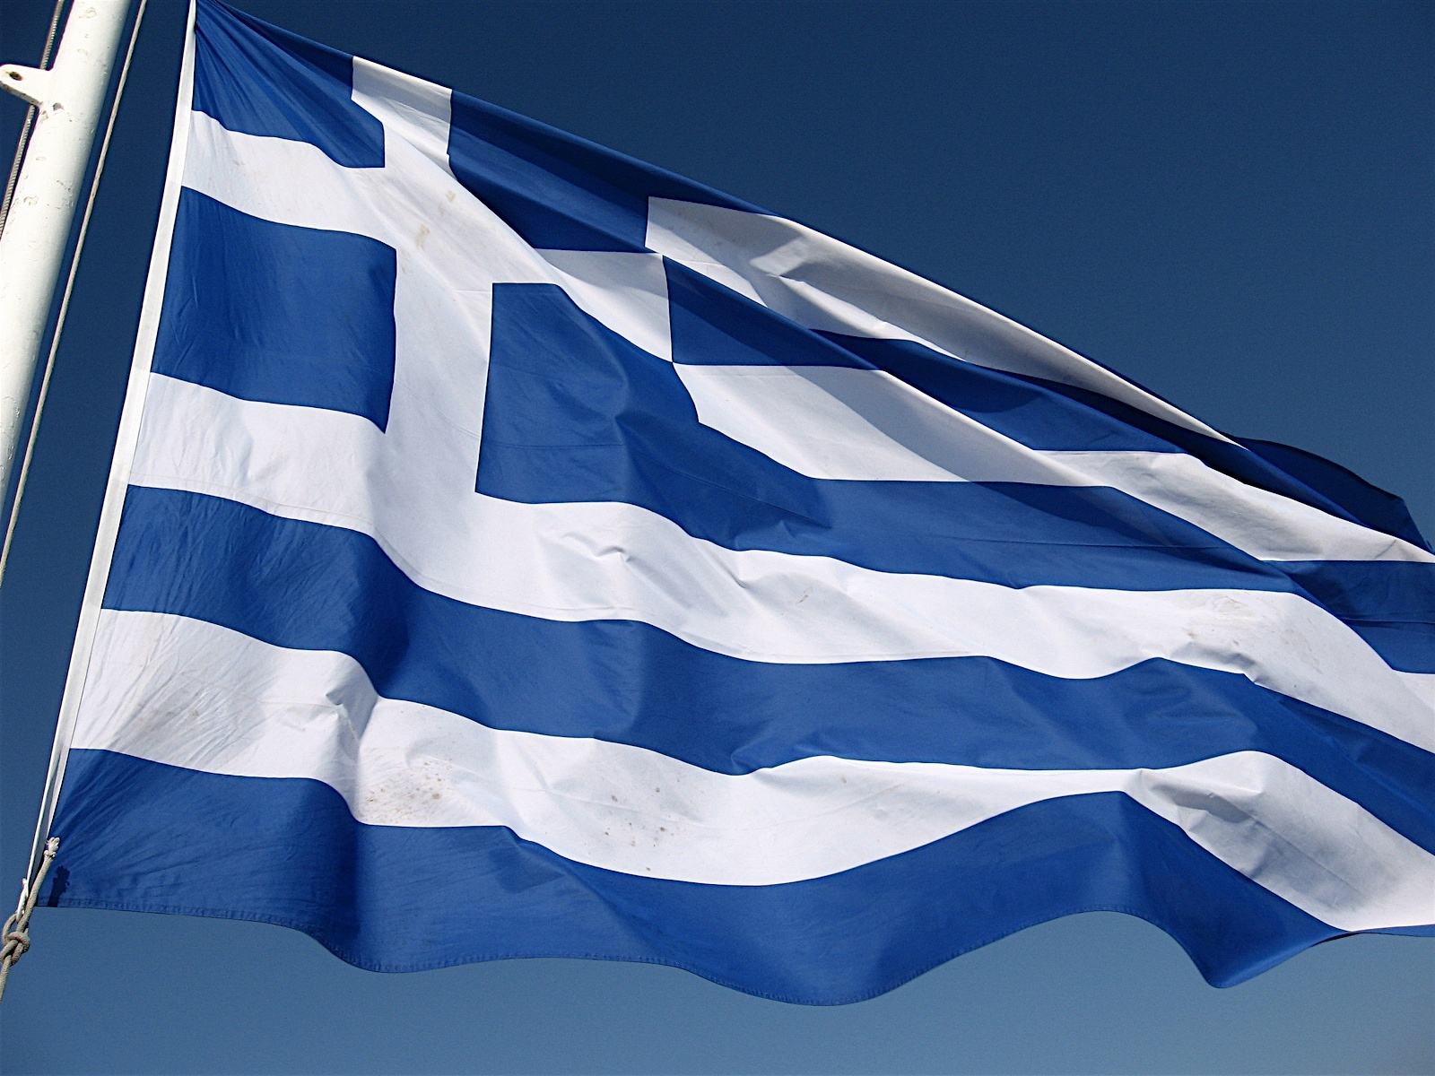
Traditional Greek Food
The Greek cuisine in general
Gemista
Dolmathakia
Melomakarona

Slide 2
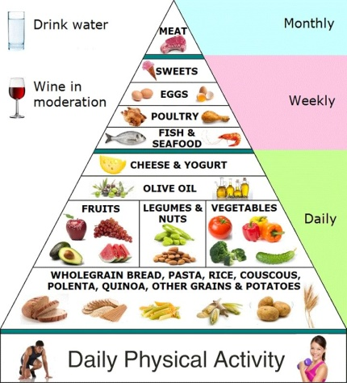
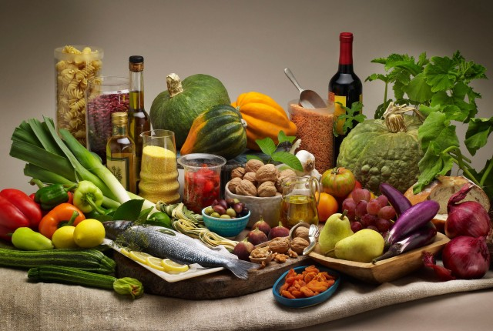
The Greek cuisine
Greece has an ancient culinary tradition dating back several million years, and over the centuries Greek cuisine has evolved and absorbed numerous influences and influenced many cuisines itself. Greek cuisine is a Mediterranean cuisine . It has some common characteristics with the traditional cuisines of Italy, the Balkans, Israel, Turkey, and the Levant.
Contemporary Greek cookery makes wide use of vegetables, olive oil, grains, fish, wine and meat .Other important ingredients include olives, cheese ,eggplant, zucchini, lemon juice, vegetables, herbs, bread and yoghurt. The most commonly used grain is wheat; barley is also used. Common dessert ingredients include nuts, honey, fruits, and filo pastry.
In general the Greek cuisine is one of the most healthy an balanced diets in the world that combines the right amounts of every food category.

Slide 3
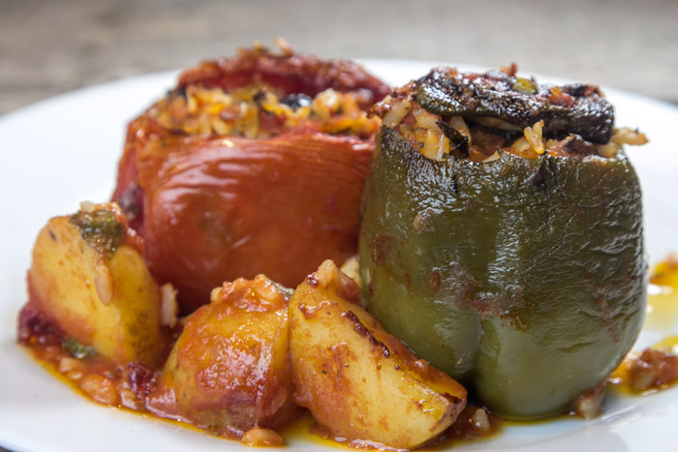
Gemista
Gemista is one of the most popular traditional foods in Greece. Everybody prepares it because it is easy and tasty in one.
Every household has its own recipe but in general, gemista are stuffed vegetables like tomatoes or peppers with a filling that is mostly rice or meat. It is basically a summer food and it is usually served with potatoes, feta cheese or Greek yogurt.
THE RECIPIE
12-15 tomatoes,
green peppers or red,
zucchini,
eggplant or what we like
oil
200 g. rice
2-4 onions,2-4 cloves garlic
2 carrots
1 bunch parsley, finely chopped little mint and fennel or dill (if you have)
little breadcrumbs
Potatoes
salt, pepper, a little sugar
We empty the vegetables and make a whole to put in there the feeling. Then, we place he vegetables in the baking pan and springle pepper, salt and sugar on them. After that, we poor the other vegetables and the breadcrumbs in a blender and mix them. Then, we combine them with the rice, a little water, oil, salt and pepper and put them in the whole of the tomatos and peppers. After that, we cut the potatos, place them in the bakking pan and cook them for 1h at 180 degrees

Slide 4
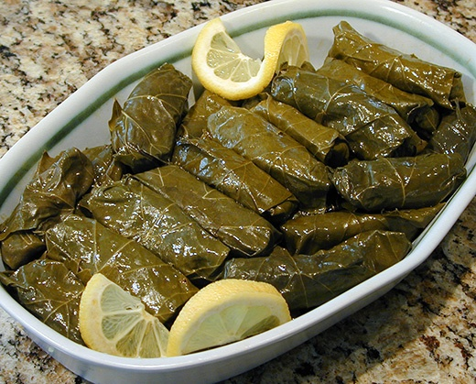
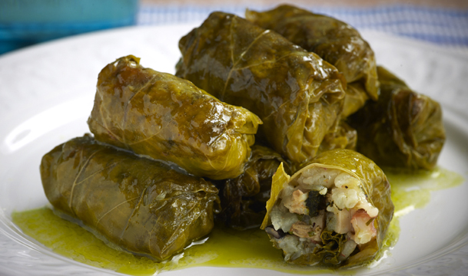
Dolmathakia
To make dolmathakia ,you will have to first wash and heat the leaves for 2-3 minutes. After that you have to prepare the feeling. To do this, you have to pour in a bowl, the onions ,the rice, the parsley, the dill, salt and ½ olive oil and mix it. Then you must take one leave, put some of the feeling in there and close it all together. At the end, you put the leaves filled with the rice in a pan, pour he other half olive, water and lemon and you simmer.
Dolmas is a very representive traditional food too that is similar to Gemista.
we meet this food in Greek cuisine and the cuisines of the former Ottoman Empire and surrounding regions, such as Russia, Middle East, Caucasia and Central and South Asia. Perhaps the best known is the one made with vine leaves, while in Greece also used lettuce and cabbage leaves to wrap the filling.
The Recipie
250 g. leaves
1 bunch green onions, chopped
2 onions, grated
250 g. Carolina rice
1/2 bunch parsley, finely chopped
1/2 bunch chopped dill
a little chopped mint
1 cup olive oil
1 1/4 cup boiling water
juice of 1 lemon 1/2
Salt Pepper

Slide 5
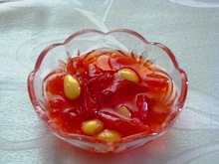
Preserves
This desert is really representative for the Greek cuisine, as it was served many years ago to the guests in special occasions or even when someone came to visit. You can also make it with other fruits.
The recipe
1200 grams quinces
750 grams sugar
200 grams of water
1 lemon
2 sprigs of ginger leaves
5-6 drops of lemon
80 grams of almonds peeled uncooked cut in half
To make this Greek traditional sweet, you will have to first wash and peel off the quinces. Then you’ll have to cut them in very thin stripes and put them in a pan with water ,sugar, the ginger sleeves the lemon and the almonds and cook it until they are soft. When it starts to foam, take a spoon and remove the foam. After you have done this, let it cook by its one for about 60 minutes. At the end, take it down the heat and pour 5-6 drops of lemon and put it into jars to keep it fresh.

